Slide 1
Should AFS to take action against climate change?
Is this really a fisheries issue or better for climatologists or other NGOs?
Do scientific organizations or AFS have a history of confronting major issues?

Slide 2
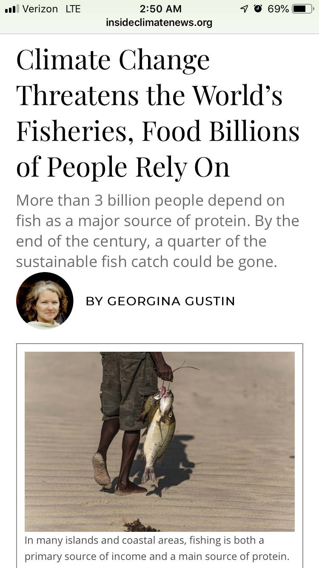
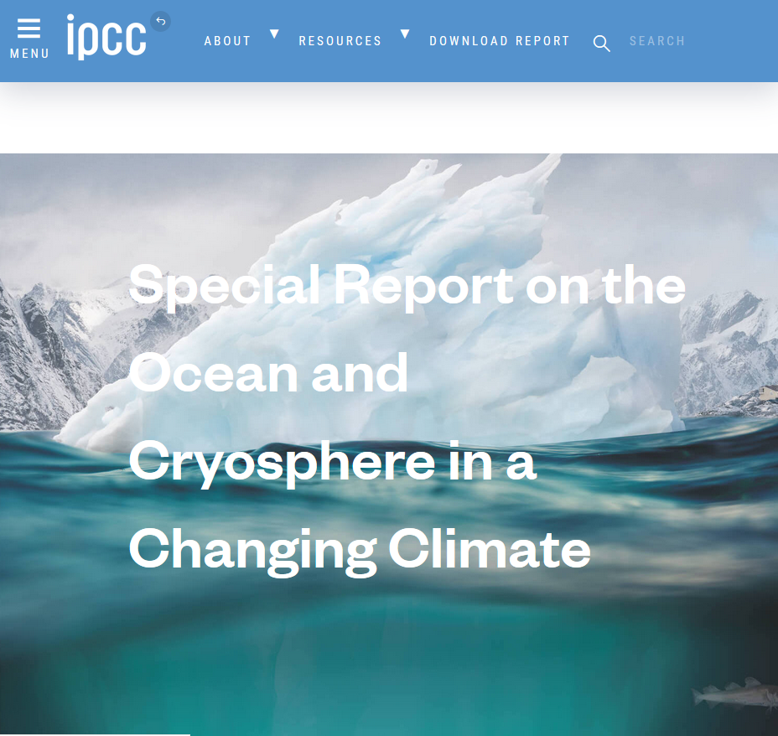
Released: September 25, 2019

Slide 3
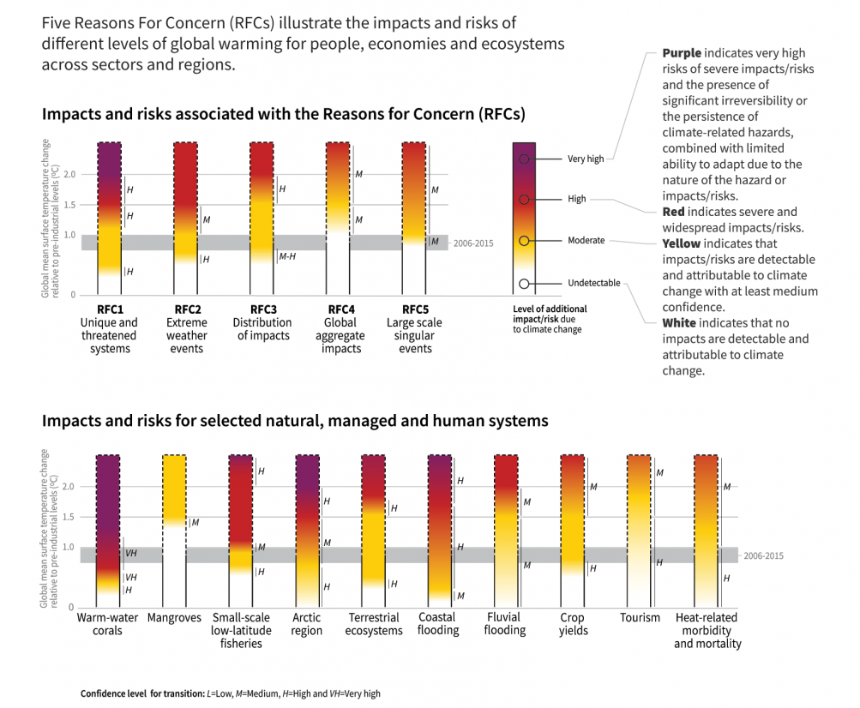
IPCC, 2018: Summary for Policymakers. In: Global Warming of 1.5°C.

Slide 4
Climate change has already had large effects on aquatic systems and associated fisheries. Effects include:
General:
A meta-analysis of 27 studies concerning a total of 976 species found that 47% of local extinctions reported across the globe during the 20th century could be attributed to climate change.⁷ This is significantly higher for animals and for freshwater habitats.
Recent survey of 136 freshwater, marine, and terrestrial studies suggests species interactions are often the immediate cause of local extinctions due to climate change.⁸
Global ecological and monetary costs associated with invasive species are substantial (more than $1.4 trillion annually). New species interactions are being created with climate change, combinations never before seen.⁸
Invasive species have more opportunities to invade because the defense of natural communities are reduced in a stressed environment, and conditions can become more favorable for nonnative species in an altered environment.⁸
Many ecosystem changes can be avoided only by substantially reducing carbon dioxide and other greenhouse gas emissions.⁸
Freshwater: Freshwater ecosystems are considered among the most threatened on the planet.⁹ Here are some of the effects that climate change has already brought and will bring.
Climate change is altering abundance, predator-prey dynamics, growth and recruitment of North American freshwater fishes, especially coldwater species like trout.¹⁰
Suitable habitat of for trout is expected to decline by 47% under an ecologically friendly emission scenario.¹¹
The geographical ranges of many freshwater plant and animal species have moved over the last several decades – approximately 17 km per decade poleward and 11 m up in altitude per decade.⁹ (This is for aquatic organisms that can move).

Slide 5
By the end of the century (2090), cold water recreational fishing days are predicted to decline leading to losses in recreational fishing value ranging from $1.7-3.1 Billion per year, depending on emissions scenario.⁸
Salmon populations are being affected by low snowpack, decreasing summer stream flow, higher storm intensity and flooding, physiological and behavioral sensitivity, and increasing mortality due to warmer stream and ocean temps.⁸
Climate change is already affecting food webs and species interactions. For example, brown bears in Alaska have switched from salmon to feeding on earlier-ripening berries, causing shifts in salmon mortality and nutrient seeding of Alaskan streams. ^{8,12}
Higher temperature and heavy precipitation, runoff from nutrient rich habitats are associated with harmful algae blooms in Lake Erie.⁸
Lamprey thermal habitat increasing in the Great Lakes.⁸
In the Southwest, droughts, intense downpours, increased evaporation, reduced snowpack combined with growing population is increasing water demands both for fish and people.^{13,14}
Forest area burned by wildfires from 1984-2015 is estimated to be twice what it would have been in the absence of climate change.¹⁵ Increased wildfire has huge effects on aquatic systems through floods, and reductions in water quality.¹⁴
Drought exacerbates declines in groundwater when other water sources are taxed and people turn to increased groundwater pumping. This is impacting spring and groundwater dependent ecosystems.¹⁴
Increased glacier melting under climate change affects hydrological regimes downstream (stream temperature, runoff timing), in turn affecting aquatic ecosystems.¹⁴
Habitat loss and fragmentation reduces both abundance and diversity of freshwater species. Vulnerability of bull trout due to low genetic diversity is highest where maximum temperature and winter flood risk is highest.¹⁶
Reestablishing connections or assisted migration in fragmented systems important in face of climate change (e.g. salmon and trout accessibility to colder waters).⁸
Freshwater sportfishing has 30.1 million anglers contributing $29.9 billion per year on trips and equipment.¹⁷

Slide 6
Marine
Fisheries and aquaculture important to global food security are already facing risks from ocean warming and acidification.¹⁸
The marine recreational and commercial fisheries sector of the United States alone contributes $200 billion in economic activity each year and supports 1.6 million jobs.¹⁹
Projected increases in ocean temperature are expected to lead to declines in maximum catch potential in all U.S. regions (Gulf of Mexico, West Coast, East Coast) except Alaska, which will increase.²⁰
Total fish catches in Alaska waters projected to increase, but species specific fisheries will decline such as Bering Sea pollock.⁸
Cumulative consumer losses of $230 million across all U.S. shellfish fisheries are anticipated by 2099 under higher emission scenario.²⁰
Climate change combined with other practices (pollution, overfishing, unsustainable coastal development) will drive many small-scale fisheries out of existence as a food source.¹⁸
Potential global catch for marine fisheries will likely decrease by over 3,000,000 metric tons for each degree of warming.¹⁸
Climate change is creating aquatic communities ecologically different from those currently occupying areas. This affects regional economies, fisheries harvest, cultural heritage and shoreline protection.²⁰
Carbon emissions affect the oceans through warming, acidification and deoxygenation.²⁰
Warming affects sea levels, ocean circulations, stratification, productivity and entire ecosystems.²⁰ These factors interact with each other and other stressors in the environment.
A warming ocean and freshwaters cause fish and other aquatic organisms to shift their ranges to those more suitable for their temperature tolerances.²¹
Marine organisms are shifting their biogeographical ranges to higher relatively cooler latitudes at rates that range from 0-40 km/yr.¹⁸ This has implications for local commercial/sport/aquaculture fisheries and the economies that depend on them.
Higher global temperatures are likely to result in decreases in marine biodiversity at the equator and increases at higher latitudes.²⁰

Slide 7
Temperature changes affecting ocean current and wind patterns have affected phytoplankton and zooplankton communities, impacting ocean food webs.²⁰
Timing for species processes have shifted dramatically – for example timing of phytoplankton blooms in both marine and freshwater systems are shifting, with affects across the entire aquatic ecosystem.⁸
Texas Gulf Coast temps increase grey snapper expanding northward, while summer flounder, a popular catch becoming less abundant impacting recreational and commercial catches.⁸
Shifts in production and phenology of economically important fish and shellfish including marine groundfish, inland fishes, migratory fish such as salmon, northern shrimp and lobster.⁸
Blue crab, fiddler crab moving farther north, changing ecosystems.⁸
Range changes of herbivorous fishes have changed kelp forests to kelp-free sites.⁸
Potential changes in Ocean productivity because of greater stratification due to warming.⁸
The most valuable fisheries in the United States, American lobster, is expected to decline under a high emission scenario.²⁰
Loss of sea ice in the arctic affecting algae blooms and where and when they occur. Impacts fisheries and top-level predators.²⁰
Krill depend on sea ice, sea ice habitat for krill declining.¹⁸
Summer sea ice declined 130,000 km² per year (this is about the area of Louisiana) from 1997-2014. This was four times as fast of the decline during 1979-1996.¹⁸
Climate change presents risk for seagrass and mangrove communities through temperature increases and sea level rise.¹⁸
Major heat waves have already occurred along the Northeast (2012) and West Coasts (2014-2016). Changes seen include appearance of warmwater species, increased mortality of marine mammals, harmful algae blooms. These factors economically stressed some of the nations most valuable fisheries.²⁰
Heat wave in 2012 responsible for earlier and larger lobster catch overwhelming processors and market demand. Price collapsed and reduced income for lobster fishermen⁸
Large toxic algal blooms affecting Dungeness crab fisheries, contributing to deaths of sea lions and humpback whales in North Pacific 2014-2016 heat wave.²⁰
Climate change could have a positive effect on those activities that benefit from warmer weather (beachgoing etc.)⁸
Excess carbon entering the ocean causes the ocean water to turn more acidic (ocean acidification).²⁰
The majority of marine ecosystems in the United States now experience acidified conditions that are entirely different than those before the industrial revolution.²⁰

Slide 8
The ocean has absorbed about 30% of the anthropogenic CO2, resulting in ocean acidification and changes to carbonate chemistry that are unprecedented for at least the last 65 million years.¹⁸
Models estimate that under higher emission scenarios, by 2050, 86% of marine ecosystems will experience temperatures and pH that have never been experienced by modern species.²⁰
Coral reefs and sea ice ecosystems currently among those most drastically being affected by climate change.²⁰
Organisms with calcium carbonate shells at high risk with ocean acidification.¹⁸
Multiple lines of evidence indicate that the majority (70-90%) of tropical coral reefs that exist now will disappear, even if global warming is constrained to 1.5C.¹⁸
In the last three years alone, large coral-reef systems such as the Great Barrier Reef have lost as much as 50% of their shallow-water corals.¹⁸
Some coral reefs already flattening without recovery¹⁸
Warming led to mass bleaching and/or outbreaks of coral diseases off Puerto Rico, U.S. Virgin Islands, Florida, Hawai’i, and U.S. Affiliated Pacific islands. Coral reefs experience moderate to severe bleaching during 2015-2016 bleaching events.²⁰
Loss of recreational benefits alone from coral reef ecosystems in the United States alone is expected to reach $140 billion by 2100.²⁰
Nearly all existing species will be excluded from tropical reef communities by 2115 under higher emission scenarios.²⁰
A more acidic ocean prevents shellfish from forming shells. Bivalves, pteropods, shell dissolution already occurring¹⁸
Pacific and Atlantic Coast shellfish growers are now monitoring pH and CO2 and adjusting waters to reduce acidity.²⁰
Coastal wetlands providing storm protection and habitat for fishes and other aquatic organisms are being lost. Between 2004-2009 it was estimated that wetland environments were being lost on average at a rate of 80,160 acres per year.²²
Coastal wetland loss rate in Louisiana huge due in part to high rates of sea level rise. Rate of wetland loss – one football field every 34-100 minutes.⁸

Slide 9
“In the absence of significant reduction in carbon emissions, transformative impacts on ocean ecosystems cannot be avoided.²⁰
References
¹Walsh, J., D. Wuebbles, K. Hayhoe, J. Kossin, K. Kunkel, G. Stephens, P. Thorne, R. Vose, M. Wehner, J. Willis, D. Anderson, S. Doney, R. Feely, P. Hennon, V. Kharin, T. Knutson, F. Landerer, T. Lenton, J. Kennedy, and R. Somerville, 2014: Ch. 2: Our Changing Climate. Climate Change Impacts in the United States: The Third National Climate Assessment, J. M. Melillo, Terese (T.C.) Richmond, and G. W. Yohe, Eds., U.S. Global Change Research Program, 19-67. doi:10.7930/J0KW5CXT.
²IPCC [Intergovernmental Panel on Climate Change]. Climate Change 2007: The Physical Science Basis. Contribution of Working Group I to the Fourth Assessment Report of the Intergovernmental Panel on Climate Change. Cambridge University Press, United Kingdom.
³Frölicher, T.L., M. Winton, J.L. Sarmiento. 2014. Continued global warming after CO₂ emissions stoppage, Nature Climate Change, 4, 40-44.
⁴Mann, M. E., Z. Zhang, M. K. Hughes, R. S. Bradley, S. K. Miller, S. Rutherford, and F. Ni, 2008: Proxy-based reconstructions of hemispheric and global surface temperature variations over the past two millennia. Proceedings of the National Academy of Sciences, 105, 13252–13257, doi:10.1073/pnas.0805721105.
⁵Wuebbles, D.J., D.R. Easterling, K. Hayhoe, T. Knutson, R.E. Kopp, J.P. Kossin, K.E. Kunkel, A.N. LeGrande, C. Mears, W.V. Sweet, P.C. Taylor, R.S. Vose, and M.F. Wehner, 2017: Our globally changing climate. In: Climate Science Special Report: Fourth National Climate Assessment, Volume I [Wuebbles, D.J., D.W. Fahey, K.A. Hibbard, D.J. Dokken, B.C. Stewart, and T.K. Maycock (eds.)]. U.S. Global Change Research Program, Washington, DC, USA, pp. 35-72, doi: 10.7930/J08S4N35.
⁶Muntean, M., Guizzardi, D., Schaaf, E., Crippa, M., Solazzo, E., Olivier, J.G.J., Vignati, E. Fossil CO2 emissions of all world countries - 2018 Report, EUR 29433 EN, Publications Office of the European Union, Luxembourg, 2018, ISBN 978-92-79-97240-9, doi:10.2760/30158, JRC113738.
⁷Wiens, J. J. 2016. Climate-related local extinctions are already widespread among plant and animal species. PLOS Biology https://doi.org/10.1371/journal.pbio 2001104.

Slide 10
⁸Lipton, D., M. A. Rubenstein, S.R. Weiskopf, S. Carter, J. Peterson, L. Crozier, M. Fogarty, S. Gaichas, K.J.W. Hyde, T.L. Morelli, J. Morisette, H. Moustahfid, R. Muñoz, R. Poudel, M.D. Staudinger, C. Stock, L. Thompson, R. Waples, and J.F. Weltzin, 2018: Ecosystems, Ecosystem Services, and Biodiversity. In Impacts, Risks, and Adaptation in the United States: Fourth National Climate Assessment, Volume II [Reidmiller, D.R., C.W. Avery, D.R. Easterling, K.E. Kunkel, K.L.M. Lewis, T.K. Maycock, and B.C. Stewart (eds.)]. U.S. Global Change Research Program, Washington, DC, USA. doi: 10.7930/NCA4.2018.CH7
⁹Settele, J., R. Scholes, R. Betts, S. Bunn, P. Leadley, D. Nepstad, J.T. Overpeck, and M.A. Taboada, 2014: Terrestrial and inland water systems. In: Climate Change 2014: Impacts,Adaptation, and Vulnerability. Part A: Global and Sectoral Aspects. Contribution of Working Group II to the Fifth Assessment Report of the Intergovernmental Panel on Climate Change [Field, C.B., V.R. Barros, D.J. Dokken, K.J. Mach, M.D. Mastrandrea, T.E. Bilir, M. Chatterjee, K.L. Ebi, Y.O. Estrada, R.C. Genova, B. Girma, E.S. Kissel, A.N. Levy, S. MacCracken, P.R. Mastrandrea, and L.L.White (eds.)]. Cambridge University Press, Cambridge, United Kingdom and New York, NY, USA, pp. 271-359.
¹⁰Lynch, A. J., Myers, B. J. E., Chu, C., Eby, L. A., Falke, J. A., Kovach, R. P., Krabbenhoft, T. J., Kwak, T. J., Lyons, J., Paukert, C. P. and J. E. Whitney. Climate Change Effects on North American Inland Fish Populations and Assemblages. Fisheries 41(7):346-361.
¹¹Wenger, S. J., D. J. Isaak, C. H. Luce, H. M. Neville, K. D. Fausch, J. B. Dunham, D. C. Dauwalter, M. K. Young, M. M. Elsner, B. E. Rieman, A. F. Hamlet, and J. E. Williams. 2011. Flow regime, temperature, and biotic interactions drive differential declines of trout species under climate change. Proceedings of the National Academy of Sciences 108:14175–14180.
¹²Deacy, W. W., J. B. Armstrong, W. B. Leacock, C. T. Robbins, D. D. Gustine, E. J. Ward, J. A. Erlenbach, and J. A. Stanford, 2017: Phenological synchronization disrupts trophic interactions between Kodiak brown bears and salmon. Proceedings of the National Academy of Sciences of the United States of America, 114 (39), 10432–10437. doi:10.1073/pnas.1705248114.
¹³Overpeck, J. T., and S. A. Bonar. In Press. Southwestern fish and aquatic systems: The climate challenge. Pages xx-xx in Propst, D., J. Williams, K. Bestgen, C. Hoagstrom. Standing between life and extinction. The University of Chicago Press.

Slide 11
¹⁴Lall, U., T. Johnson, P. Colohan, A. Aghakouchak, C. Brown, G. McCabe, R. Pulwarty, and A. Sankarasubramanian, 2018: Water. In Impacts, Risks, and Adaptation in the United States: Fourth National Climate Assessment, Volume II [Reidmiller, D.R., C.W. Avery, D.R. Easterling, K.E. Kunkel, K.L.M. Lewis, T.K. Maycock, and B.C. Stewart (eds.)]. U.S. Global Change Research Program, Washington, DC, USA. doi: 10.7930/NCA4.2018.CH3
¹⁵Vose, J.M., D.L. Peterson, G.M. Domke, C.J. Fettig, L.A. Joyce, R.E. Keane, C.H. Luce, J.P. Prestemon, L.E. Band, J.S. Clark, N.E. Cooley, A. D’Amato, and J.E. Halofsky, 2018: Forests. In Impacts, Risks, and Adaptation in the United States: Fourth National Climate Assessment, Volume II [Reidmiller, D.R., C.W. Avery, D.R. Easterling, K.E. Kunkel, K.L.M. Lewis, T.K. Maycock, and B.C. Stewart (eds.)]. U.S. Global Change Research Program, Washington, DC, USA. doi: 10.7930/NCA4.2018.CH6
¹⁶Kovach, R. P., C. C. Muhlfeld, A. A. Wade, B. K. Hand, D. C. Whited, P. W. DeHaan, R. Al-Chokhachy, and G. Luikart, 2015: Genetic diversity is related to climatic variation and vulnerability in threatened bull trout. Global Change Biology, 21 (7), 2510–2524. doi:10.1111/gcb.12850.
¹⁷U.S. Department of the Interior, U.S. Fish and Wildlife Service, and U.S. Department of Commerce, U.S. Census Bureau. 2016 National Survey of Fishing, Hunting, and Wildlife-Associated Recreation.
¹⁸Hoegh-Guldberg, O., D. Jacob, M. Taylor, M. Bindi, S. Brown, I. Camilloni, A. Diedhiou, R. Djalante, K. Ebi, F. Engelbrecht, J. Guiot, Y. Hijioka, S. Mehrotra, A. Payne, S. I. Seneviratne, A. Thomas, R. Warren, G. Zhou, 2018, Impacts of 1.5°C global warming on natural and human systems. In: Global warming of 1.5°C. An IPCC Special Report on the impacts of global warming of 1.5°C above pre-industrial levels and related global greenhouse gas emission pathways, in the context of strengthening the global response to the threat of climate change, sustainable development, and efforts to eradicate poverty [V. Masson-Delmotte, P. Zhai, H. O. Pörtner, D. Roberts, J. Skea, P.R. Shukla, A. Pirani, W. Moufouma-Okia, C. Péan, R. Pidcock, S. Connors, J. B. R. Matthews, Y. Chen, X. Zhou, M. I. Gomis, E. Lonnoy, T. Maycock, M. Tignor, T. Waterfield (eds.)]. In Press.
¹⁹NOAA Fisheries, 2017: Fisheries Economics of the United States, 2015. NOAA Technical Memorandum NMFS-F/SPO-170. NOAA National Marine Fisheries Service, Office of Science and Technology, Silver Spring, MD, 245 pp. URL.

Slide 12
²⁰Pershing, A.J., R.B. Griffis, E.B. Jewett, C.T. Armstrong, J.F. Bruno, D.S. Busch, A.C. Haynie, S.A. Siedlecki, and D. Tommasi, 2018: Oceans and Marine Resources. In Impacts, Risks, and Adaptation in the United States: Fourth National Climate Assessment, Volume II [Reidmiller, D.R., C.W. Avery, D.R. Easterling, K.E. Kunkel, K.L.M. Lewis, T.K. Maycock, and B.C. Stewart (eds.)]. U.S. Global Change Research Program, Washington, DC, USA. doi: 10.7930/NCA4.2018.CH9
²¹IPCC, 2014: Climate Change 2014: Synthesis Report. Contribution of Working Groups I, II and III to the Fifth Assessment Report of the Intergovernmental Panel on Climate Change [Core Writing Team, R.K. Pachauri and L.A. Meyer (eds.)]. IPCC, Geneva, Switzerland, 151 pp.
²²Fleming, E., J. Payne, W. Sweet, M. Craghan, J. Haines, J.F. Hart, H. Stiller, and A. Sutton-Grier, 2018: Coastal Effects. In Impacts, Risks, and Adaptation in the United States: Fourth National Climate Assessment, Volume II [Reidmiller, D.R., C.W. Avery, D.R. Easterling, K.E. Kunkel, K.L.M. Lewis, T.K. Maycock, and B.C. Stewart (eds.)]. U.S. Global Change Research Program, Washington, DC, USA. doi: 10.7930/NCA4.2018.CH8

Slide 13
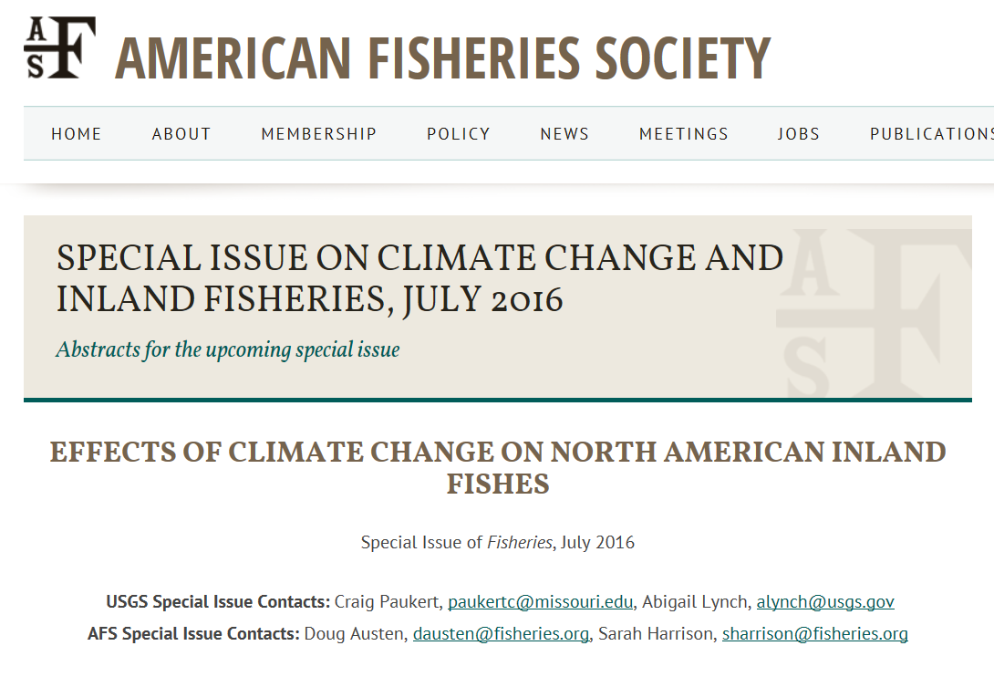
AFS has a history of important work reporting climate change effects. Can we now focus on more ideas for action?

Slide 14
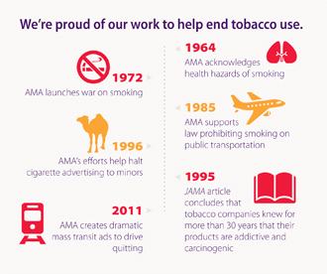
Other scientific societies tackle major issues over long time periods
American Medical Association and tobacco use

Slide 15
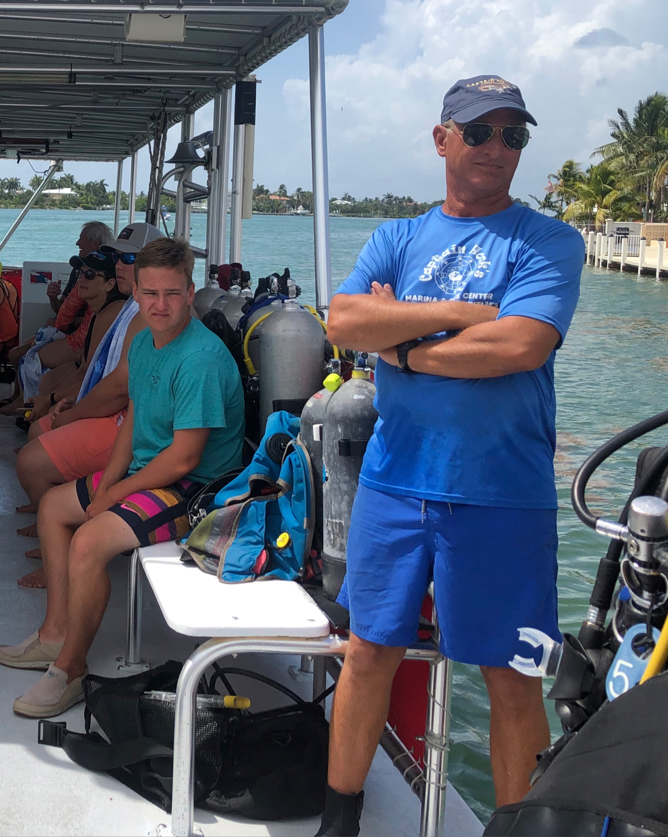
Don’t our constituents depend on us?

Slide 16
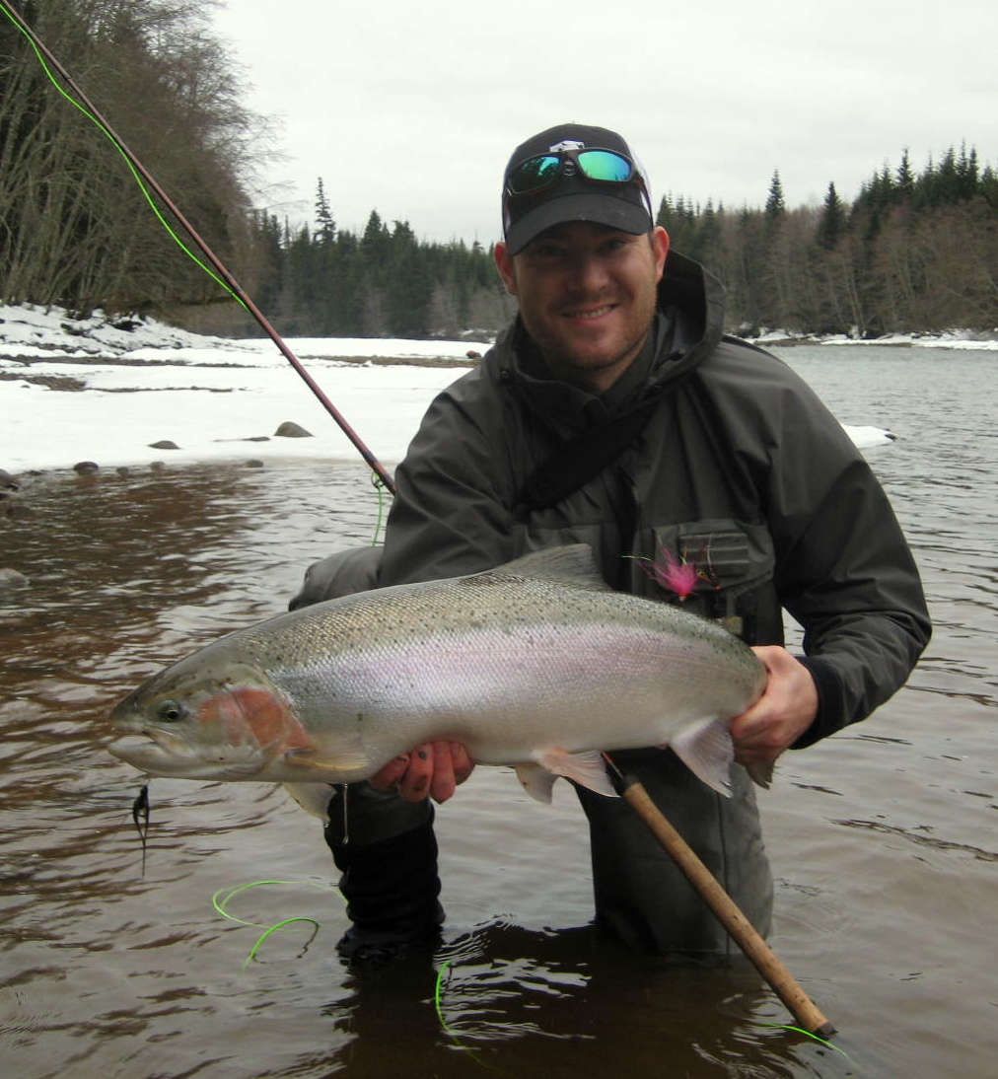
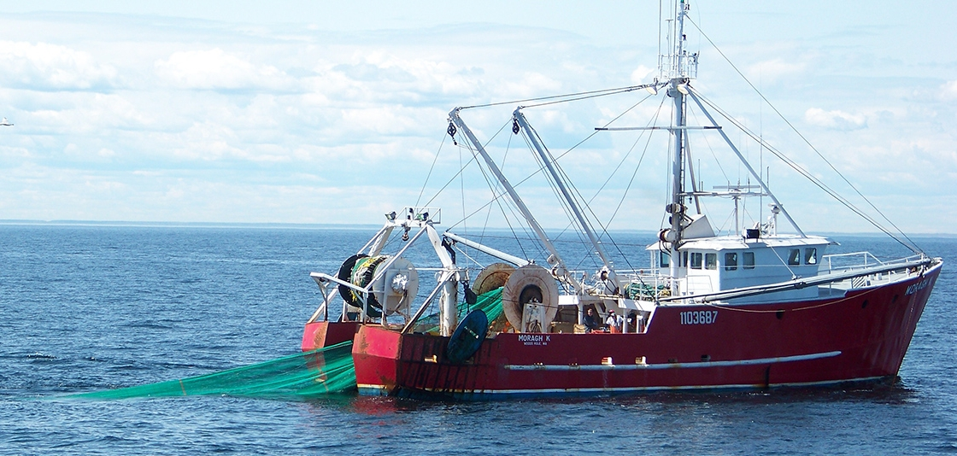
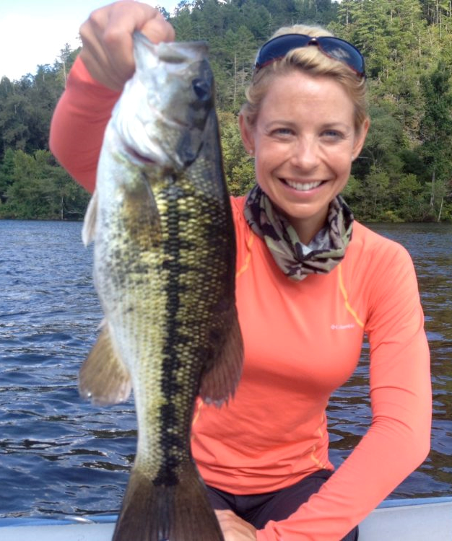
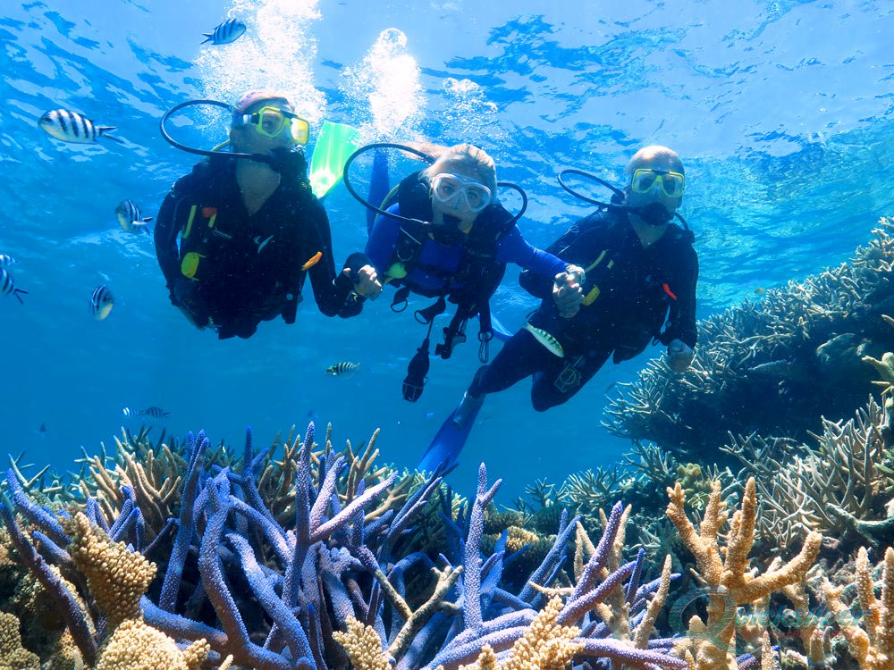
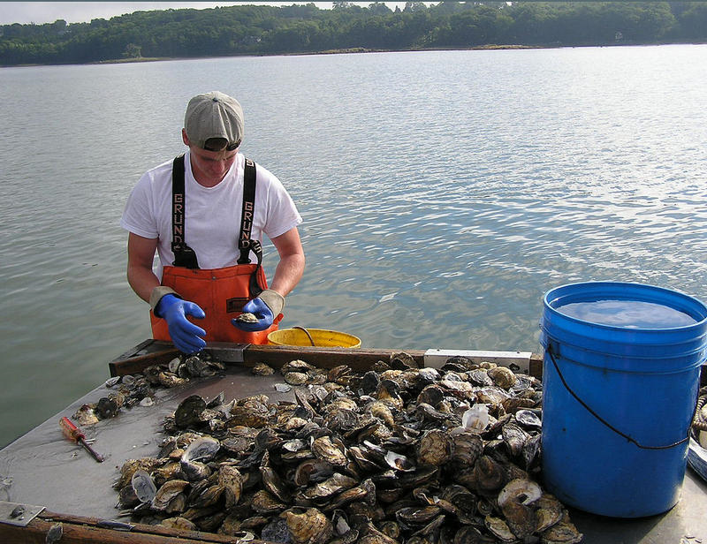
What about continued job/opportunity loss in fisheries if we don’t do anything?
Who will bring fisheries science to bear to help these people?

Slide 17
Outreach can be tough!
“It is difficult to get a man to understand something, when his salary depends upon his not understanding it!”
Upton Sinclair

Slide 18
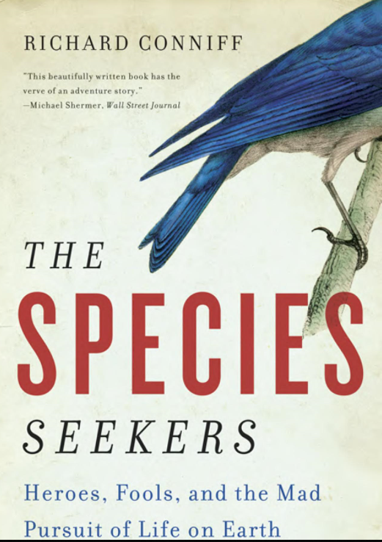
Natural scientists have always faced adversity…
Physical Harm
Threats
Job Losses or Transfers
….And their work has resulted in HUGE benefits to society!

Slide 19
Helpful Information:
Intergovernmental Panel on Climate Change (IPCC)
https://www.ipcc.ch/
4th National Climate Assessment
https://nca2018.globalchange.gov/
Skeptical Science
https://skepticalscience.com/
AFS Web Site
https://fisheries.org/
AFS Webinar: Verbal Judo: A method to talk to people hostile to conservation
fisheries.org/verbaljudo
Notes:
Discussion time.

