Slide 1
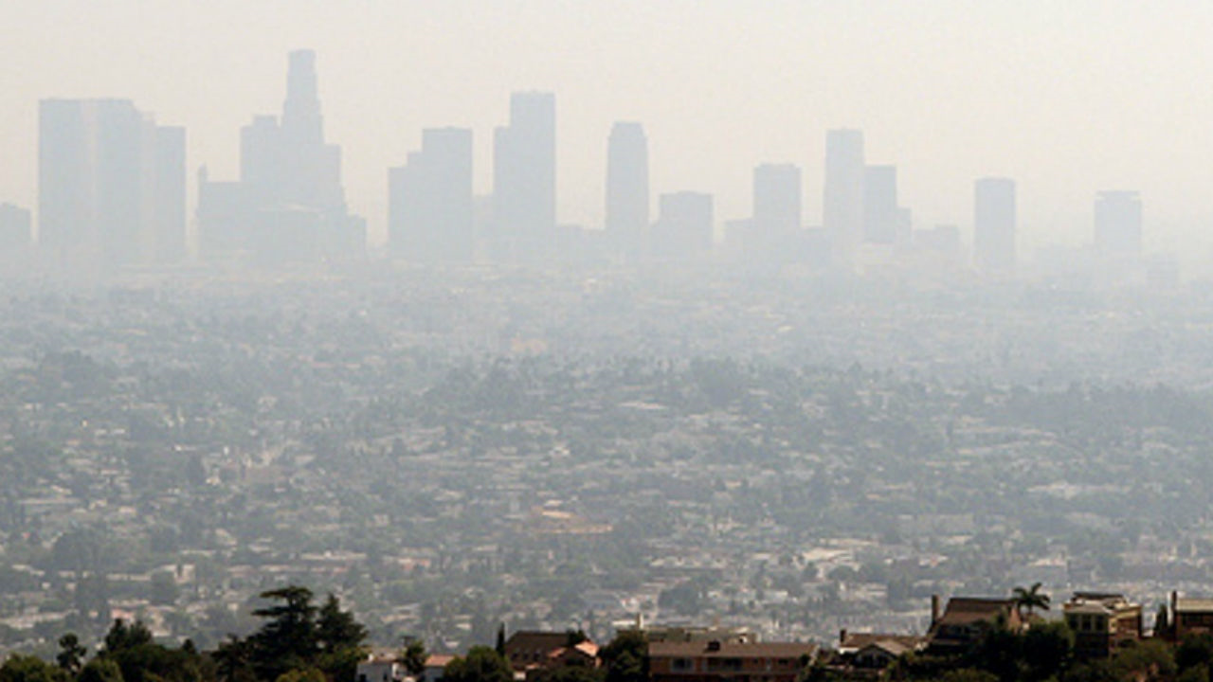
AFS Climate Change Outreach (General Public and Profession)

Slide 2
Joint Statement of AFS/TWS
“If we are to safeguard our own wellbeing as a species, it is imperative that the scientific underpinnings of fish and wildlife conservation and management are heard and used to find solutions.”

Slide 3
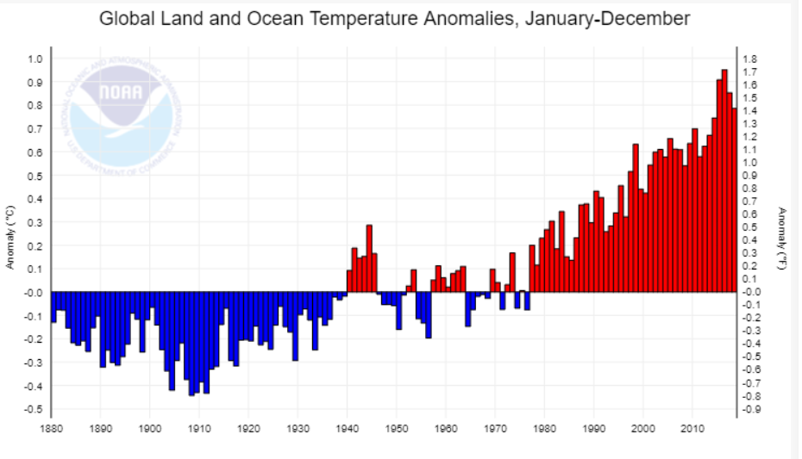
Peer Reviewed Data and Studies
Notes:
No doubt temperatures are warming - Global is going up. NOAA data.

Slide 4
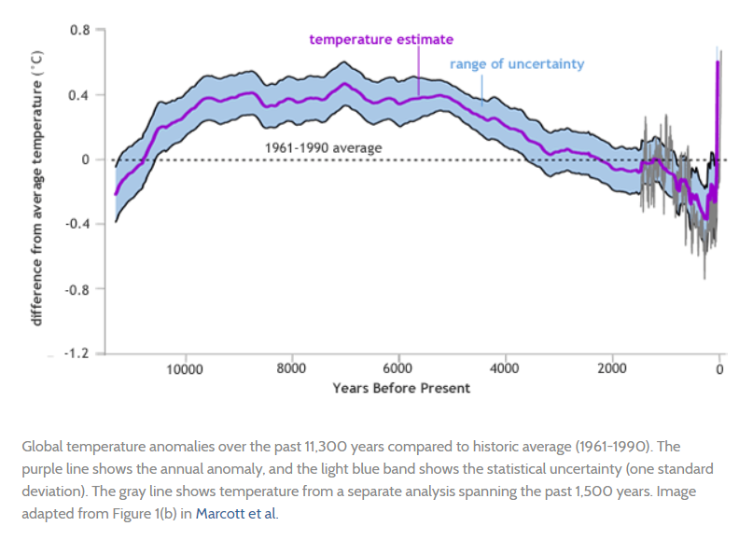
Marcott, S. A., J. D. Shakun, P. U. Clark, and A. Mix. 2013. A Reconstruction of Regional and Global Temperature for the Past 11,300 Years. Science 339(1198).
Notes:
More recently temperature has been followed back about 11,000 years ago. Look at how fast recent change is!

Slide 5
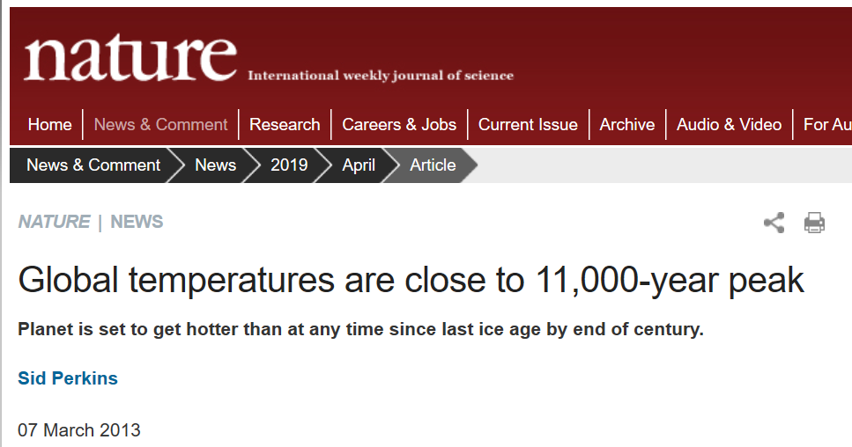

Slide 6
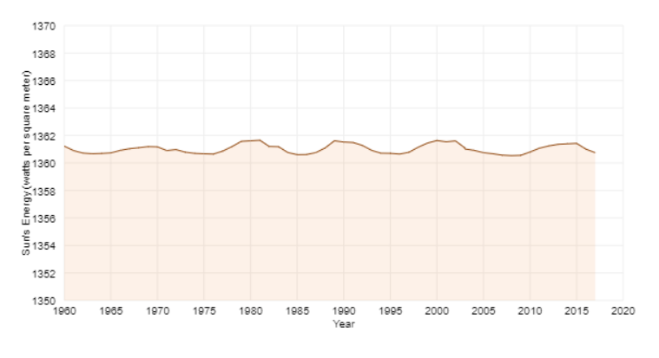
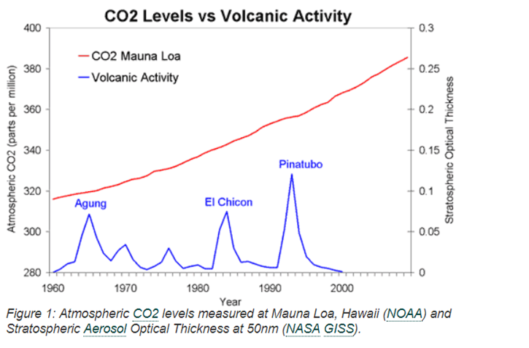
What is related to current climate change?
Not incoming energy from the sun…
From NOAA website (https://www.climate.gov/news-features/understanding-climate/climate-change-incoming-sunlight) Data courtesy of Greg Kopp, Laboratory for Atmospheric and Space Physics, University of Colorado; and Judith Lean, Space Science Division, Naval Research Laboratory.
Not volcanic activity…
Notes:
Incoming sun energy has been stable.

Slide 7
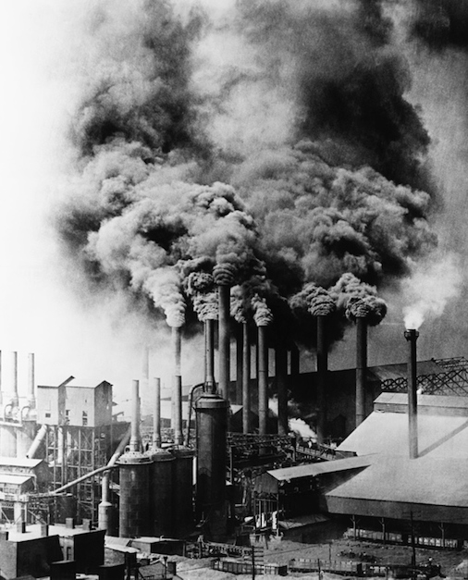
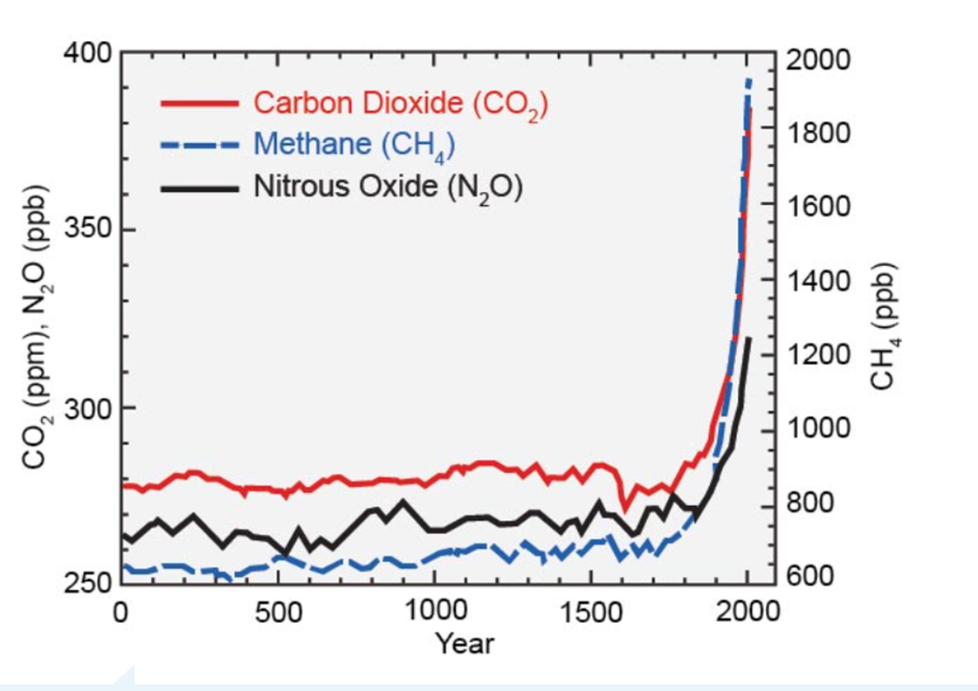
It’s human emissions of greenhouse gasses!
Billions of tons of CO₂ pumped into atmosphere since industrial revolution
Climate Change 2007: The Physical Science Basis. Contribution of Working Group I to the Fourth Assessment Report (AR4) of the Intergovernmental Panel on Climate Change

Slide 8
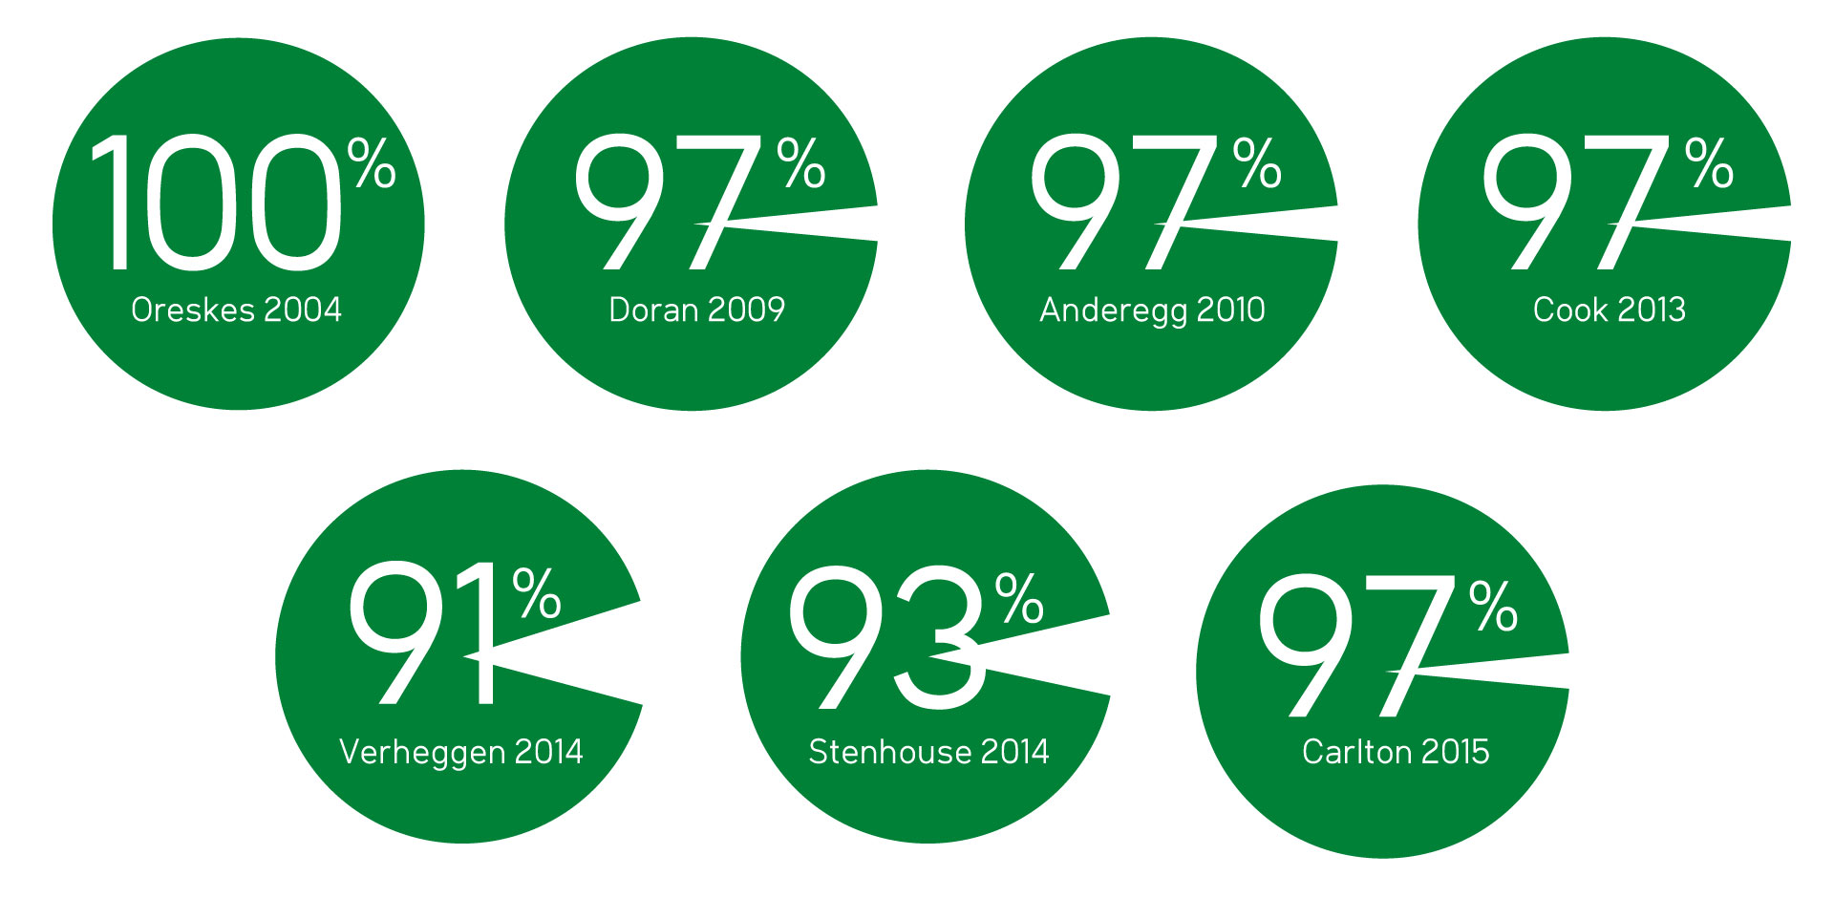
Overwhelming consensus of climate scientists who have published peer-reviewed climate research, or peer-reviewed climate papers that human-caused climate change is occurring.
John Cook et al. 2016. Consensus on consensus: a synthesis of consensus estimates on
human-caused global warming. Environ. Res. Lett. 11 048002
Notes:
So what is the consensus of these experts? The people who did these studies included some science historians who are judged not by climatologists but by those who are experts in studying science history.

Slide 9
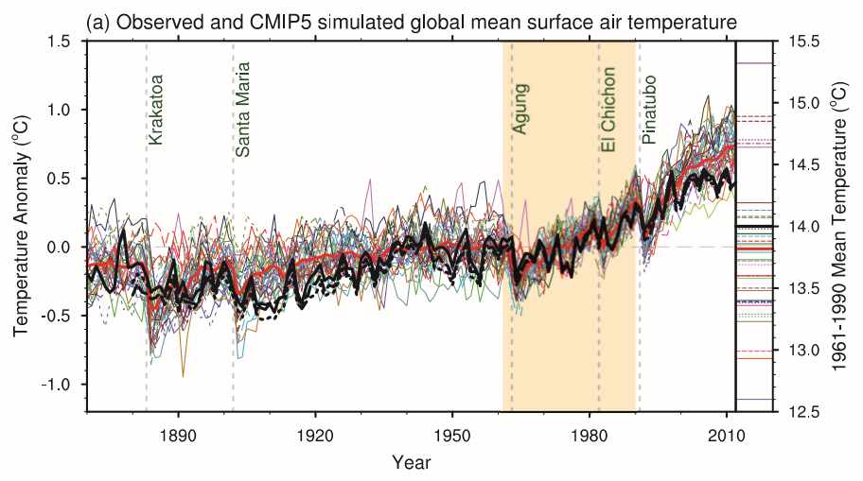
Models fit historic data well
Notes:
How good are these models?

Slide 10
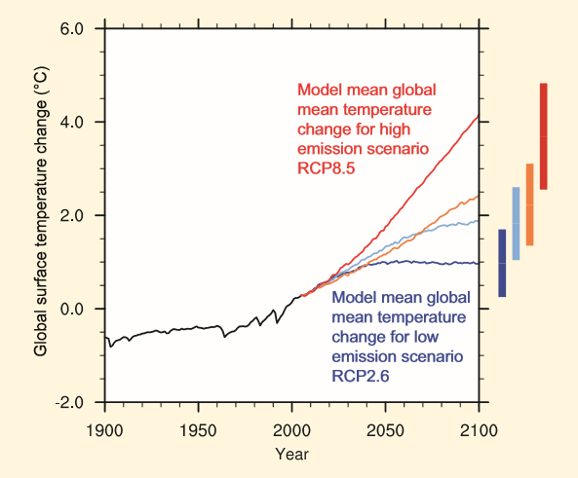
…and predict a dire future unless emissions reduced
Notes:
What do models say is going to happen?

Slide 11
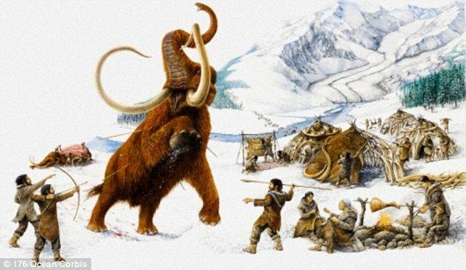
Is a 1.5-5.5°C (2.7-9.9°F) change to global temperature a lot?
Global mean surface temperature was 4-9°C (7-16°F) colder in last ice age…
IPCC, 2013: Climate Change 2013: The Physical Science Basis.
Notes:
1.5-5.5 is a LOT globally

Slide 12
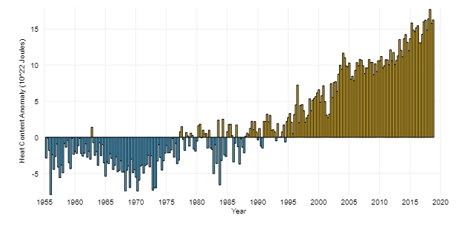
…Once committed, there is no going back
>90% of warming in the last 50 years has occurred in ocean
Heat stored in ocean eventually released, committing earth to additional warming in future
From NOAA, https://www.climate.gov/news-features/understanding-climate/climate-change-ocean-heat-content
Notes:
We can’t just go back when we add heat and CO2. It is stored in the Ocean.

Slide 13
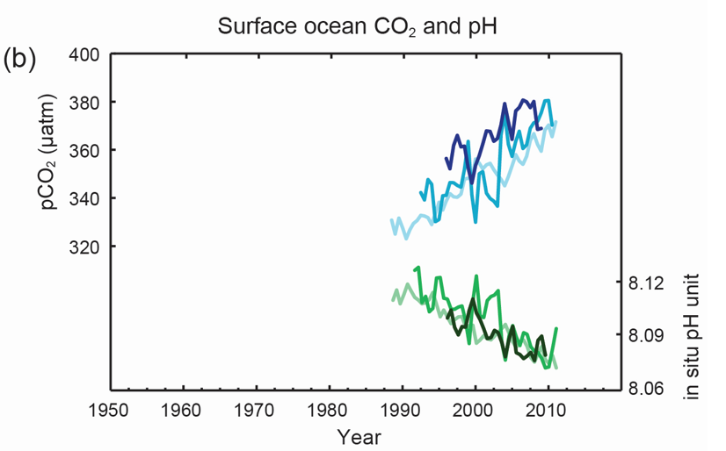
Added CO₂ also increases ocean acidity
IPCC, 2013: Climate Change 2013: The Physical Science Basis.
Notes:
pH in ocean is going down, Acidity is going up.

Slide 14
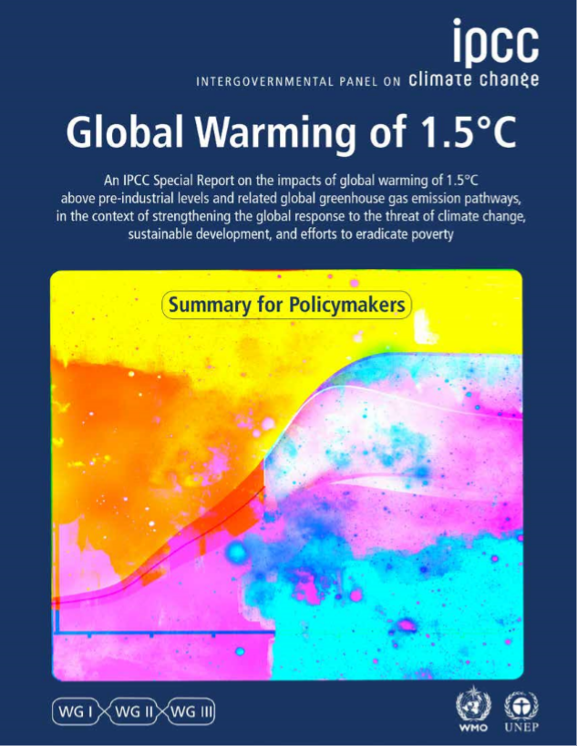
What to do?
“Avoiding overshoot (of 1.5°C) and reliance on future large-scale deployment of carbon dioxide removal (CDR) can only be achieved if global CO2 emissions start to decline well before 2030.” ¹
IPCC, 2018: Summary for Policymakers. In: Global Warming of 1.5°C.
¹underline and bold added.

